Slide 1
Advanced Phone and Voice Mail Training

Slide 2
Training Deck Navigation
During the presentation you can hold your mouse over the lower left corner and select an arrow to replay or advance a slide

Slide 3
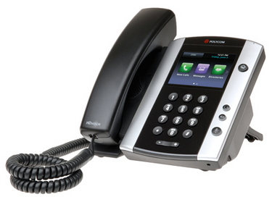
Phone Navigation
Message Waiting Indicator
Color Touch Screen
Home Key
Notes:
This is a picture of a Polycom VVX400 handset. The VVX410 looks and functions identically, but it supports GigE.
Discuss highlights of the phone:
Message Waiting Indicator – This light will flash read when you have a new voicemail message in your mailbox.
Headset – All 400/410s are headset compatible. Jack is located in the back of the phone at the bottom.
Mute – When activated, this button will illuminate Red. It will mute your end of the conversation whether you are on the handset, headset or speaker phone. To unmute, simple press the Mute button again, all parties on the call will now be able to hear you.
Speaker – All phones are speakerphone capable. Press the Speaker bottom to make/receive a call. If you are on the handset or headset and want to move to the Speakerphone, simply press the Speaker button and you will move your conversation to the speakerphone.
Volume – adjust the volume up/down, for the feature you are using. As an example, if you are on the handset and adjust the volume, it only impacts the volume on the handset. Handsfree, headset and the ringing volume would need to be done independently.

Slide 4
Phone Navigation, Continued
Headset
Speaker
Mute
Notes:
This is a picture of a Polycom VVX400 handset. The VVX410 looks and functions identically, but it supports GigE.
Discuss highlights of the phone:
Message Waiting Indicator – This light will flash read when you have a new voicemail message in your mailbox.
Headset – All 400/410s are headset compatible. Jack is located in the back of the phone at the bottom.
Mute – When activated, this button will illuminate Red. It will mute your end of the conversation whether you are on the handset, headset or speaker phone. To unmute, simple press the Mute button again, all parties on the call will now be able to hear you.
Speaker – All phones are speakerphone capable. Press the Speaker bottom to make/receive a call. If you are on the handset or headset and want to move to the Speakerphone, simply press the Speaker button and you will move your conversation to the speakerphone.
Volume – adjust the volume up/down, for the feature you are using. As an example, if you are on the handset and adjust the volume, it only impacts the volume on the handset. Handsfree, headset and the ringing volume would need to be done independently.

Slide 5
Phone Navigation, Continued
Volume
Notes:
This is a picture of a Polycom VVX400 handset. The VVX410 looks and functions identically, but it supports GigE.
Discuss highlights of the phone:
Message Waiting Indicator – This light will flash read when you have a new voicemail message in your mailbox.
Headset – All 400/410s are headset compatible. Jack is located in the back of the phone at the bottom.
Mute – When activated, this button will illuminate Red. It will mute your end of the conversation whether you are on the handset, headset or speaker phone. To unmute, simple press the Mute button again, all parties on the call will now be able to hear you.
Speaker – All phones are speakerphone capable. Press the Speaker bottom to make/receive a call. If you are on the handset or headset and want to move to the Speakerphone, simply press the Speaker button and you will move your conversation to the speakerphone.
Volume – adjust the volume up/down, for the feature you are using. As an example, if you are on the handset and adjust the volume, it only impacts the volume on the handset. Handsfree, headset and the ringing volume would need to be done independently.

Slide 6
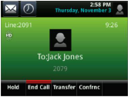
Common Soft Key Layout
On-Hook
During a Call
Callers
DND
More
Pickup
To Vmail
Hold
More
Forward
Callers Forward DND More
Pickup To Vmail Hold More
Note: The Soft Key Layout may vary by site and the current activity on the phone
Notes:
As you are using your phone, the soft key options will change depending on the status of your phone. These features may, or may not, be available, depending on the features requested by your company. As you being using your new phone, make note of the options that are associated to the keys at the bottom of the display. Must of your functionality for call processing will be associated with those keys. This concept is very similar to the softkeys on your cell phone. If you have a “more” softkey, that key can be used while on a call to access additional features, it will not disconnect your caller.

Slide 7
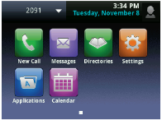
Home Page
Home Page
Directories
Settings
Press the Home button to access advanced features and settings
Change ring tones
Set ringing to silent
Enable/Disable Call Forwarding
Enable/Disable DND
Inbound Call Log
Outbound Call Log
Missed Call Log
Notes:
The Home key or Home Page gives you access to features such as Directories, Calls Logs, Forwarding, DND and allows you flexibility in controlling ring tones and turning the ringer off if you are monitoring other individuals on your phone. When you press the Home button, use the navigation keys to scroll or navigate to the feature you wish to access.

Slide 8
Make a Call – Internal and External Dial Plan
When Calling… | Dial…
Phones In Your Office | 5-Digit Extension + # (May sometimes be 7-digit)
Phones In Other Offices | 10-Digit Phone Number
Local | 10-Digit Phone Number
Long Distance | 10-Digit Phone Number
Toll-Free | 10-Digit Phone Number
International | 011 + Country Code + City Code + Number
TTY | 711
Emergency Services | 911
When dialing extensions, press # after the number to make the call go through more quickly
Notes:
Customize the dial plan if necessary.
Discuss internal dialing plan – 4-digit extensions, include the importance of press # to speed up the call process. (extensions can be 2-7 digits)
Discuss outside dialing -- Local, long distance and TF are straight 10-digits, no longer require a “9” for an outside call or a 1 for LD or TF.
Discuss international – no “9” required, 011 for international, then country code, city code and number
Discuss that dialing “0” for the operator, 411, 711 and 911 also does not require a “9”
Review again adding a # after dialing anything less than 10-digits will speed up the call, and that 411 may not be available to them and if it is, there will be charges for using directory assistance.
Remind the users that 911 is tied to their service address of their phone.

Slide 9
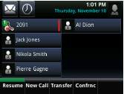
Placing a Call on Hold
Hold
Auto-Hold
To place a call on hold, press the Hold soft or hard key
To retrieve the held call, press the Resume soft key
If you are on a call and a second line begins to ring, press the Answer soft key
You can alternate between callers by selecting the held line key to make your selection, and then pressing the Resume soft key
This will automatically place your existing call on hold
Hold End Call Transfer Confrnc More
Resume New Call Transfer Confrnc More
Notes:
While you are on a call, if you wish to place your current caller on hold, press the Hold hard or soft key. The light next to that line key will flash, indicating that the caller is on hold. To resume your call, press the button next to the flashing line key to return to your caller.
This phone system also as a feature referred to as Auto-Hold. If you are on a call and second call appears on your phone, you simply press the key for the incoming call. This automatically places your current call on hold, and picks up the second caller. You can toggle between the two lines by simply pressing the line keys, automatically placing the other call on hold.

Slide 10
Transfer
Transfer:
Announced and Blind
Cancel Transfer
Announced Transfer: While on a call, press the Transfer soft or hard key
Dial the extension or the external number that you’d like to transfer to
You can privately announce the caller to the receiving party, then press Transfer again to complete
Blind Transfer: If you choose not to announce the transfer, simply press Transfer again as soon as you’ve entered the extension or external number
You can press the Cancel soft key at any time to return to the original caller.
Hold End Call Transfer Confrnc More
Notes:
The first Transfer I am going to discuss is Consultative Transfer. This Transfer process allows you to speak to the party you are transferring to, prior to releasing the caller to them.
With a call in progress, press the Transfer soft key or hard key. This puts your caller on hold, and provides you with interrupted dial tone. At that time, enter the extension+#, or 10-digit number+# of the party you wish to transfer to. When they answer, you can announce the caller to them, and press Transfer soft key or hard key again, or hang up to release the call. You can release the call prior to your party answering if you choose not to announce the call during a Consultative transfer.
If at any time you want to cancel the transfer process, you possibly misdialed, or the individual could not take the call, press the Cancel soft key. This will drop the current party and return you to the original caller. Note that you may need to press the More soft key to have access to the Cancel soft key. NOTE!! Be sure they understand that the caller ID to the party they are transferring to will be the caller ID of the transferring handset, not the inbound caller’s number.

Slide 11
Transferring a Call to Voicemail
To Voicemail
Cancel
While on a call, press the ToVmail soft key
Dial the extension and press the Enter soft key
The caller is immediately transferred to the employee’s mailbox
You can press the Cancel soft key before you press Enter to return to the original caller.
Note that the caller will be able to hear you until you press the Enter soft key
To Vmail Park Retrieve
Note: You may have to press More to access the Cancel soft key
Caller ID: The Caller ID in the recipients voicemail will show as the outside caller.
Notes:
The last option for transferring a caller, is to transfer them directly to voicemail. By transferring directly to voicemail, the caller goes right into voicemail, and the party you are transferring to will not hear their phone ring.
With a call in progress, press the To Vmail soft key. Note that the caller WILL still be on your line, and will be able to hear you!! They are not on hold as described in the previous Transfer scenarios. After you press To Vmail, enter the recipient’s voicemail box number (the last 4-digits of their phone number) and press the Enter soft key. The call is released, and the caller is placed directly in the recipient’s voicemail box. To cancel this process, again, press the Cancel soft key, pressing the More soft key if Cancel is not available to you. NOTE!!! The calling party’s caller ID will be captured in voicemail.

Slide 12
Making a Conference Call
Conference
Cancel Conference
While you’re on a call press the Confrnc soft key
Dial the extension or telephone number you wish to add
After you announce the call, press Confrnc again and everyone is connected
If a party doesn’t answer or can’t join the conference, press Cancel to return to the original members the call
You can repeat these steps to conference up to 15 individuals including yourself, service permitting
Hold End Call Transfer Confrnc More
Note: You may have to press More to access the Cancel soft key
Notes:
You can conference up to 15 individuals, including yourself. While on a call, press the Conference hard or soft key. This puts your current caller on hold, and they will not be able to hear you. When you hear interrupted dial tone, enter the number of the next person you want to add – either extension+# or a 10-digit outside phone number. When the party answers, announce that you are going to bring them into a conference call. While you are speaking to this party, again the party on hold cannot hear your conversation. When the caller is ready to join the conference, press the Conference hard or soft key. At this point, there are 3 parties on the call. Continue this process until all parties have been added to the conference call. If at some time one of the parties does not want to join your call, press the Cancel soft key. That will drop that party, will not affect your existing conference call, and will join you back into the conference call already in progress. Again, as with Transfer, if you cannot see a Cancel soft key, press the More soft key to display that feature.

Slide 13
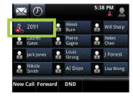
Do Not Disturb (DND)
Enable
Disable
Press the DND soft key
This will place a red icon next to your line button as a reminder that your phone is in Do Not Disturb
Callers will now go directly to voicemail
Press the DND soft key, again
The red icon will be removed, and calls will begin ringing normally
New Call Forward DND
Notes:
Do Not Disturb which is also referred to as DND, and gives you the ability to send callers directly to voicemail. You are encouraged to use this feature if you will be away from your phone such as at lunch, after hours, or when outside of the office.
To activate DND, press the Do Not Disturb hard key. This will place an “X” next to your line key. This is your visual that your phone is in DND mode. At this point, anyone calling your phone will go directly to voicemail.
To deactivate DND, press the Do Not Disturb hard key again. The “X” will be replaced by a phone icon, which is your visual that DND has been deactivated, and callers will resume ringing at your phone.

Slide 14
Using Call Logs
Call Logs
Received Calls
Placed Calls
Incoming calls to your phone that you did answer
Internal or external outbound calls that you made
Missed Calls
Incoming calls to your phone that you did not answer
Call Logs can be accessed by pressing the Callers soft key or by selecting Directories from the Home screen.
Callers Pull DND Retrieve
Note: If your phone reboots or loses power, it will clear the phone’s call logs
Notes:
You will have access to three call logs; Missed Calls, Received Calls, and Placed Calls. All three call logs can be accessed by either using the Callers soft key, or by using the navigation keys. You can dial from these logs by highlighting the number you wish to dial, and following the soft keys at the bottom of the display.
Note: If your phone reboots for any reason, you will lose your call logs from the phone, but the records will be available from your toolbar.

Slide 15
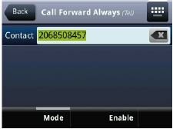
Forwarding Your Calls
Enable
Disable
Press the Forward soft key
Select Always
In the Contact field, enter the extension or 10-digit number where you’d like your calls to ring
Press the Enable soft key
Follow the same instructions as above, but select Disable to turn the feature off
Note that when this feature is used, the caller will go to the forwarding extension or external number’s voice mail box, and not to your personal mailbox
New Call Forward DND
Note: Always is the most common option, and it will forward ALL calls
Notes:
You have the ability to Forward your calls to any device outside of the office. You will have additional forwarding options via the portal and toolbar, that we will later. Be aware that with this Forwarding method, if the call is not answered at the destination it is forwarded to, that devices Voicemail will pick up; it will not return to the voicemail system for this phone.
To enable forwarding, press the Forward soft key. Within the display you will see the following options:
Always Forward
No Answer Forward
Busy Forward
Using the navigation key, highlight the forwarding option you want to activate; in most cases you will select Always Forward. With your selection highlighted, press the Select soft key. Enter the extension, or 10-digit number that you want to calls to forward to. Press the Enable soft key. This activates your forwarding and all calls at this point will ring to that device, until Forwarded is disabled.
To disable Forwarding. Press the Forward soft key, select the feature you wish to disable forwarding on, in this example, Always Forward. With Always Forward highlighted, press the Select soft key. Then press the Disable softkey, and callers will resume ringing at this device.
This system does not remember the last destination you forwarded to, so any time you want to activate Forwarding, you will need to follow this process. Again, I will demonstrate forwarding options from the toolbar, that will make this process a little easier.

Slide 16
Ways to Access Voicemail
From your Office Phone
Remote - Remote Voicemail Access Numbers
Remote - Calling your Number Directly
Press the Messages button
Press the Connect soft key
When prompted, enter your Voicemail Passcode followed by #
Dial one of your Remote Voicemail Access Numbers: 855-540-6245 or 720-857-7467
When prompted, enter your 10-digit phone number followed by #
When prompted, enter your Voicemail Passcode followed by #
Call your own 10-digit phone number
When you hear your greeting, Press 7 on your key pad
When prompted, enter your Voicemail Passcode followed by #
Notes:
Once you’ve set up your voicemail, there are two ways to access your voicemail. When you are in the office, the most convenient way is to press your Messages key and then press the Connect soft key. The system recognizes your extension and immediately prompts you for your passcode.
There are two ways to access voicemail from outside of the office. You can dial a ‘Voicemail Retrieval Number’, which was provided to you in your Welcome Email. When the system answers, enter your 10-digit phone number followed by #. You will then be prompted to enter your passcode, again followed by the # key.
The second way to access voicemail from outside of the office, is to call your number directly. When you hear your greeting, press the 7 key. You will then be prompted for your passcode. Enter your passcode followed by #.
All three manners of accessing voicemail allow you to change your greeting, rerecord your name, check messages, send messages, etc. You have full access to every feature in your voicemail box.

Slide 17
Voicemail Initialization Steps

Slide 18
Voicemail Initialization Steps, Continued

Slide 19
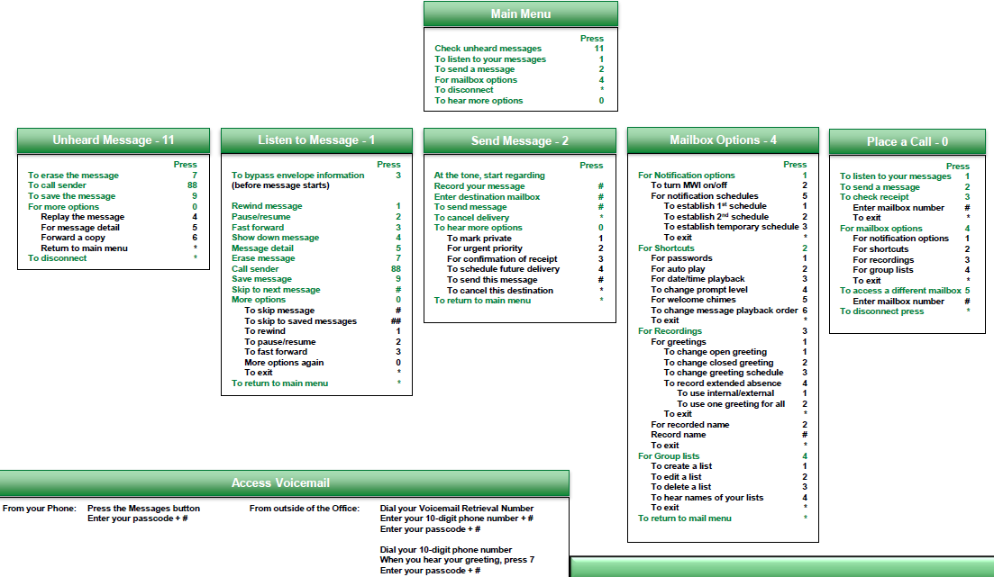
Voicemail Telephone User Interface
Listen to a Message

Slide 20
Thank you for your time today!
For questions or assistance, please contact your local administrator for support
Notes:
Last chance for questions.

